Slide 2
7
8
9
10
2
3
4
5
6
1

Slide 3
Radical Resilience
Radical – going to the root, going to the depths, going beneath the surface. . . That’s what contemplation really is: it’s paying deep attention to the deep dimensions of life.

Slide 4
Radical Resilience
Resilience – is the capacity to withstand and recover from hardship or difficulty. The ability not just to spring back into shape but take on the new shape the Spirit is molding us into.

Slide 5
Reality – We are getting smaller
153 Congregations
36 worship 1-25
39 worship 26-50
36 worship 51-100
12 worship 101-150
3 worship 151-200
4 worship over 200 (largest 309)
(23 congregations submitted no annual report to the ELCA)

Slide 6
Reality – Congregation Leadership
44 share pastoral leadership
35 are served on a part-time basis
33 are served by Synod-Authorized Ministers or lay leaders

Slide 7
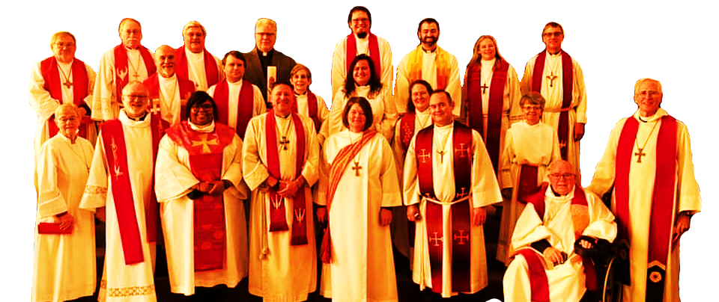
Reality – Providing pastoral leadership is a challenge

Slide 8
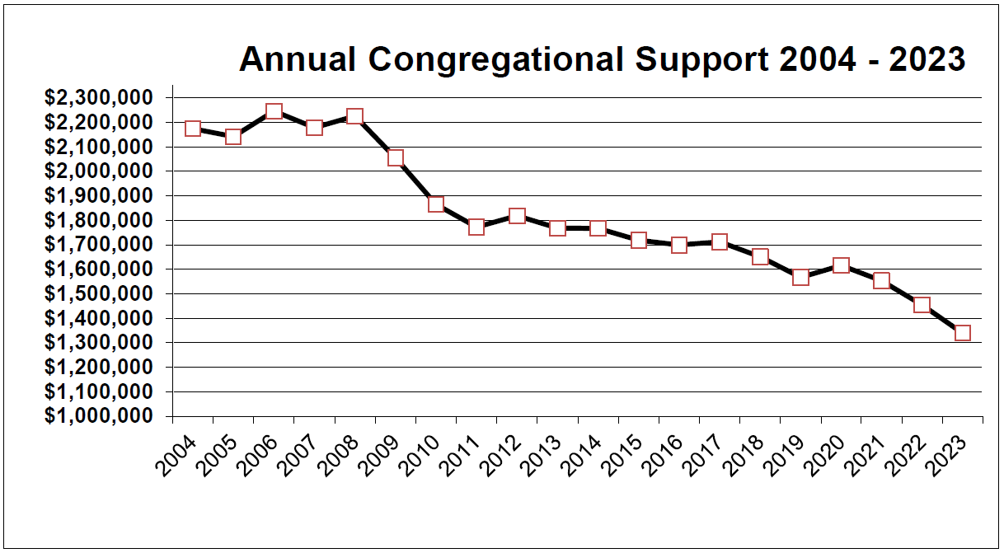
Reality – Mission Support continues to decline

Slide 9
Resilience – Where & Who is the Spirit blowing us to be?

Slide 10
Blowing us into Collaboration

Slide 11
Blowing us to Rethink Leadership

Slide 12
Blowing us to Clarify Priorities

Slide 13
7
8
9
10
2
3
4
5
6
1

Slide 14
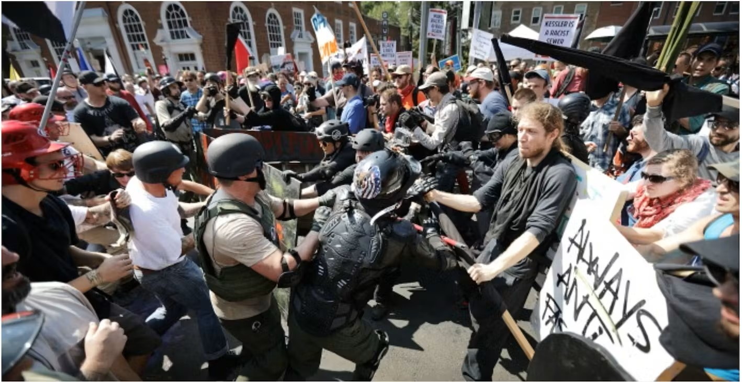
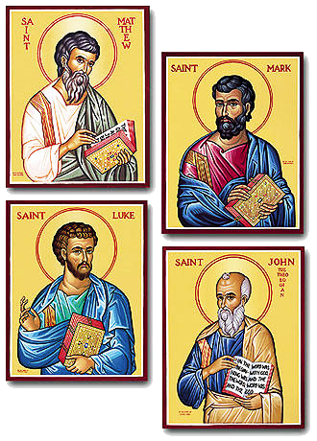
Reality –

Slide 15
The Spirit is calling us to proclaim the Gospel – a different message
The Word became flesh to dwell among us full of grace and mercy
Reign of God has come near
Blessed are the poor, persecuted, mourning, children, outsiders . . . for theirs is the kingdom of God.
For God so loved the world that God sent the Son not to condemn the world but that the word might be saved through him.
All are welcome at the feast.
Peace I give to you – not as the world gives
Just as you did it to the least of these, you did it to me.
A new commandment – that you love one another as I have loved you.

Slide 17
We will live as beautifully, bravely, and kindly as we can as long as we can, no matter how ugly, scary and mean the world becomes.

