Slide 1
Detectives of Divinity
Central States Synod Assembly
Rev. Ruben Duran
ELCA

Slide 2
THANKS
For this opportunity to be with you.
To explore together what God is doing in our neighborhoods, with our neighbors. And, discern the various roles we are called to play in the economy of God.
Grateful to Mark Lau Branson and Nicholas Warnes, editors of “Starting Missional Churches, Life With God In The Neighborhood”.
The idea of Detectives of Divinity came from the Afterword by Alan Roxburgh.

Slide 3
Biblical-Theological Tools
1. It is about God; 2 Cor. 5:17-20
God is a community in Mission
Father, Son and Holy Spirit
The 3 Amigos, reconciling the world
Creative, Diverse, United in mission
Social Trinity
Sending Trinity
Invite us to be ambassadors for God

Slide 4
Biblical-Theological Tools
2. God at work
24/7
In and through the church
In and through civil society
3. Sacramental View of Reality
2 Sacraments: water, wine, bread, word
God’s real presence in world
God in the neighbor
Free from sin, death and the evil one
Free to love and serve the neighbor

Slide 5
Biblical-Theological Tools
4. Incarnational initiative of God
John 1: 14 And God became flesh, and
dwelt among us
5. Lord’s Prayer:
“Your Kingdom come, your will be done
on earth, as it is in Heaven”
6. Priesthood of all believers: 1 Peter 2: 9-10
Ministers in everyday life
Accompanying neighbors and civil society

Slide 6


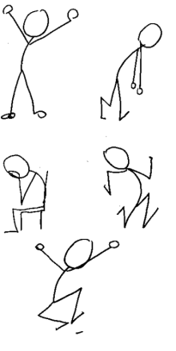
God at work
Other churches & faith communities
Public Spaces
God’s Mission
Associations
Institutions
People

Slide 7
Invited
To have more curiosity than judgement
To become “detectives of divinity”
To re-enter God’s world and discover anew:
a. What in the world is God doing?
b. How can I/we participate in it?
c. How can we do this ecumenically?

Slide 8
Detectives of Divinity
What is God up to - (church and community)
  New lenses
  Learning conversations
  Discovering with our feet
  Discovering together
  Accompanying civil society
  Ready to witness

Slide 9
Church: A Community of Detectives
Building relationships in the public arena
Restoring community
At home in church and world
Listening, Learning, Serving, Witnessing
LEARNING: Connection to context and networks of partnership increase ministry vitality.

Slide 10
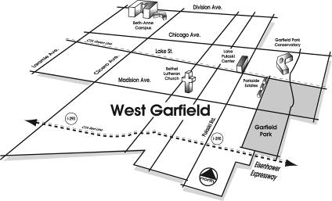
Releasing Detectives of Divinity

Slide 11
Detecting Divinity Now
1. Helicopter View: demographics
2. Street View: building relationships
3. Community Capacity View: assets, gifts
4. Power Analysis: changing systems
5. Collective Impact: effective alliances

Slide 12
1. Helicopter View
Check the demographic information
Office of Research and Evaluation, ELCA
Free service at your request
Census information and more
Give the office 2-3 weeks to get back to you with your request

Slide 13
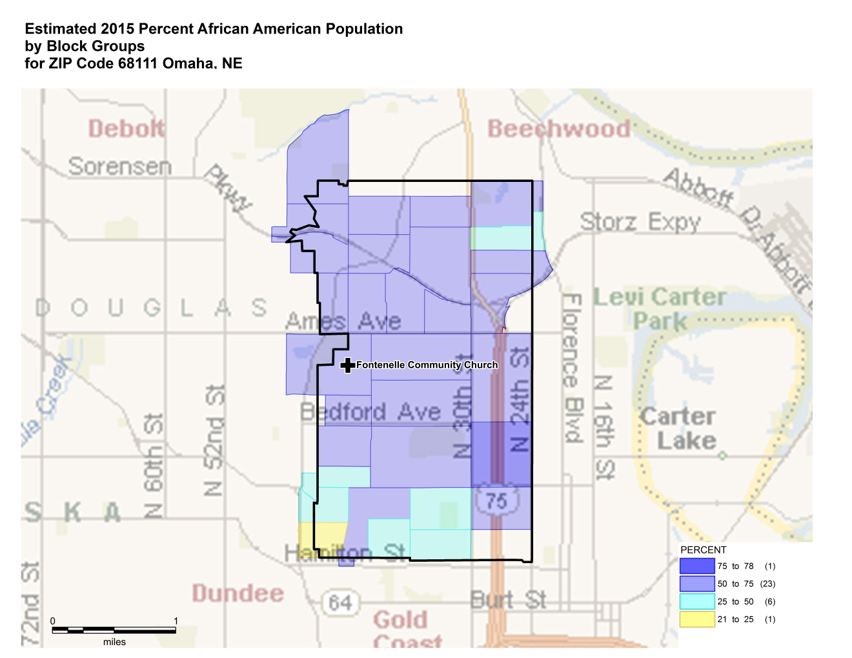


Slide 14
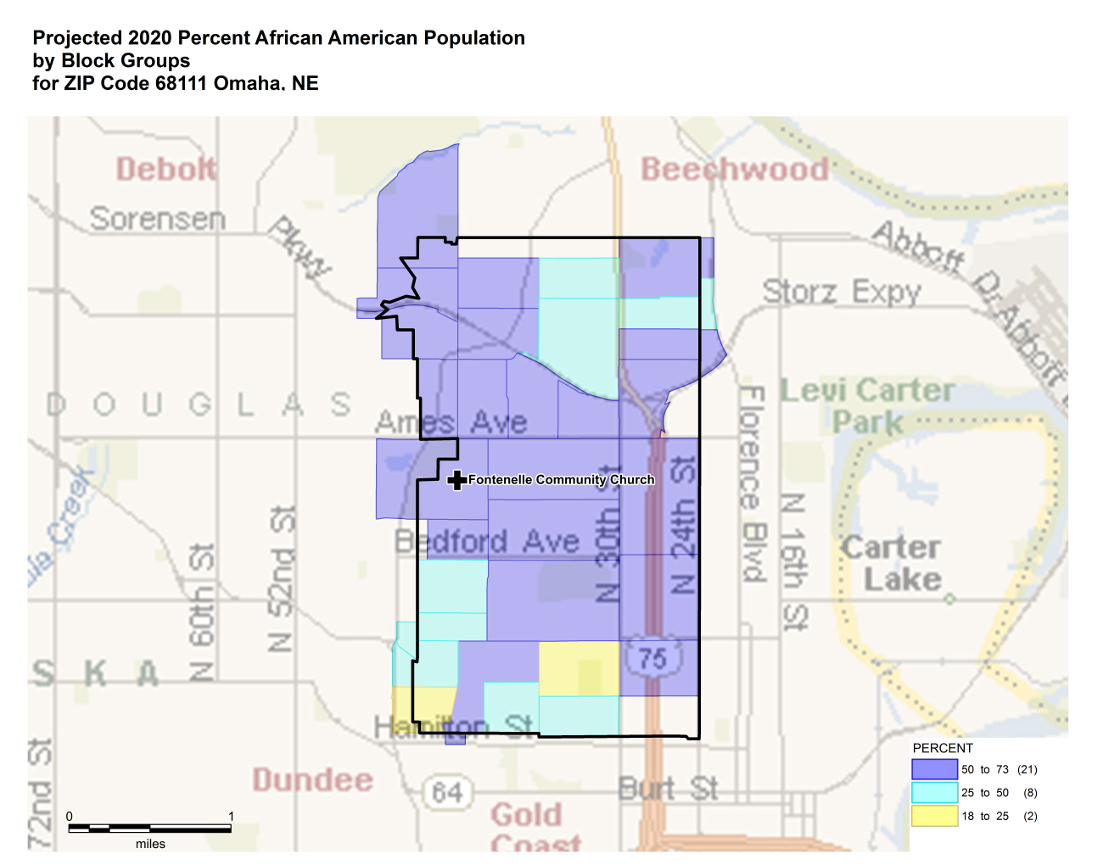

Slide 15
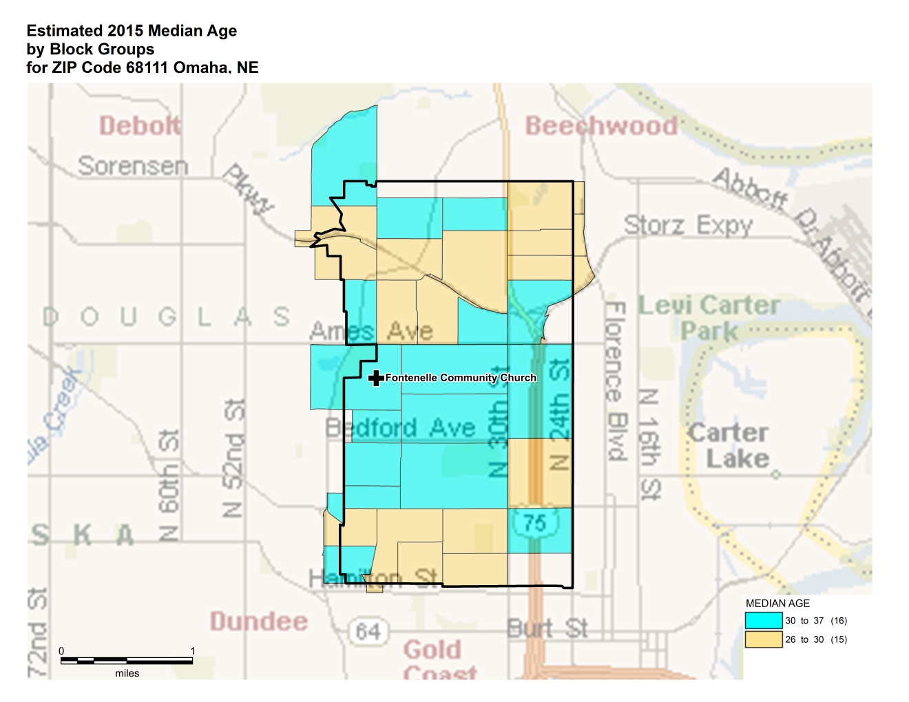

Slide 16
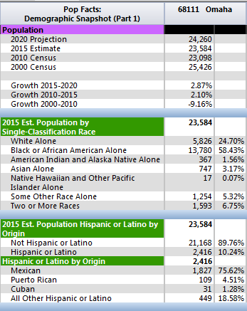
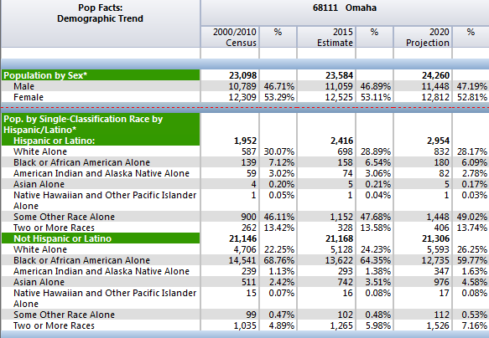
Sample from Demographic Snapshot Report
Sample from Demographic Trend Report

Slide 17
Learnings
In the ELCA, there are:
2000 churches with 20% or more African Descent population in their zip code
1,400 churches in Latino communities
900 churches in Asian communities
400 churches in or near reservations
Multicultural potential around us!!

Slide 18
2. Street View
Walk, walk and walk your area
Find ways to mingle and connect if your area is more regional or spread-out
Listen, seek understanding
Trade judgement for curiosity
Fall in love with your ministry area
Use the One on One relational tool.

Slide 19
A 1:1 is…
an intentional, uncommon conversation designed to
start or build a relationship
uncover what matters most
increase power/ability to serve, act for justice

Slide 20
LEARNING One on One CONVERSATIONS
Tell us about something good that happened in the community recently
Issues & concerns you want to work on?
Gifts, capacities & skill to share?
Strong relationships with others (associations/institutions)
Further contacts you would suggest (other people-name, phone, address)

Slide 21
Suggestion
F: family…………………….. uniqueness
O: occupation……………..what you do
R: recreation…………......free time
M: message…………what I receive/give

Slide 22
PRACTICE: 7 minutes
Groups of 3
1. Will start with questions to learn from the other, especially key interests, values, dreams for life, family, community, church.
2. Cooperate with genuine, real answers.
3. Observes the dynamic and experience.

Slide 23
3. Discover Community Capacity
Finding assets: gifts in action
Involve leaders in church and community
Villages and communities around the world discover assets to help them deal with their ever-growing needs
Combine gifts you already have and put them in action for church and community.
This is called Asset Mapping methodology

Slide 24
DISCOVERING ABUNDANCE
Asset Mapping - (community and congregation) - eyeballing
  New eyeglasses
  Learning conversations
  Discovering with our feet
  Discovering together

Slide 25
Resources
“The Great Permission”, an ELCA resource; Augsburg Fortress
Asset-Mapping resources from Luther Snow (Iowa)
Asset-Based Community Institute, at Northwestern University, Evanston, IL; Dr. Jodie Kretzman
www.pcusa.org -Starting New Initiatives. Appendix I-D; Exploring Neighborhood.

Slide 26
GOD’S VISION FOR COMMUNITY
How should we live together?
Who’s at the table? Left out?
What’s difference between
God’s vision and our reality?

Slide 27
TWO PATHS--TWO SOLUTIONS
Needs Assets
(What is not there) (What is there)
Services to meet Connections &
needs contributions
Consumers Local leaders
Programs are answer People are the answer

Slide 28
Community Assets
Businesses
Local Institutions
Schools
Associations
Churches
Block Clubs
Gifts of Residents
Parks
Income
Artists
Libraries
Youth
Elderly
Labeled/Marginalized
Social Groups Self-Help Groups
Hospitals
Nonprofits

Slide 29
Community Needs Map
Unemployment
Housing Projects
Child Abuse
Crime
Teen Mothers
Gang Members
Illiteracy
Poverty
School Dropouts
Mentally Ill
Homeless
Truancy Addiction
Uninsured
Delinquency

Slide 30
PRACTICE: groups of 2
Take a look at the ASSETS or GIFTS in your community:
Identify 1 or 2 people, associations or institutions that you and/or your church ought to build a relationship with in order to extend the ministry of your church and learn from them on an ongoing-basis.
Why are your choices important? Share

Slide 31
COMMUNITY ACTION
Go to the people
Live among them
Learn from them
Love them
Start with what they know
Build on what they have;
But of the best leaders
when their task is done
The people will remark
“We have done it ourselves.”
Lao-Tau, 700 BC

Slide 32
4. Power Analysis
Every community has a nerve
Your ministry needs to connect to that nerve and define its role based on your purpose and principles
Connect with current leaders in community centers, community development, non-for profits; community organizing groups, ecumenical partners and others.

Slide 33
Power Analysis
The one on ones relational meetings will help you get a picture of the way life is organized in your community
How are decisions made? Who has the greatest influence on those decisions?
How are those decisions affecting people?
What systems create disparity, walls of separation and/or bridges to wellbeing!!

Slide 34
Power Analysis
1. Define the issue to be addressed
2. Who are those most affected by this issue and how? Are their voices being heard?
3. Who or what entity has the ultimate power to address this issue and solve it?
What is their self-interest?
4. Who has the strongest influence in the decision-makers? What’s their self-interest
5. How can we connect #4 with #2: the base
6. What is the role of the church on this issue?

Slide 35
Practice
Acts 6:1-6. The story of the Greek Widows
Issue led to Acts 15, the 1st Churchwide Assembly.
Use Power Analysis within your church and in the community. People will help turn “walls” of division into planning “tables” for community wellbeing.

Slide 36
Acts 6:1-5
Now in these days when the disciples were increasing in number, a complaint by the Hellenists arose against the Hebrews because their widows were being neglected in the daily distribution.
And the twelve summoned the full number of the disciples and said: It is not right that we should give up preaching the word of God to serve tables.

Slide 37
Acts 6:1-5
Therefore, pick out from among you seven men of good repute, full of the Spirit and of wisdom, whom we will appoint to this duty.
We will devote ourselves to prayer and to the ministry of the word.
And they chose Stephen, full of faith and of the Holy Spirit, and Philip, and Prochorus, Nicanor, Timon, Parmenas and Nicolaus, a proselyte of Antioch.

Slide 38
PRACTICE
1. What is the issue here?
2. Who are the most affected?
3. Who has the power to fix the issue?
4. Who has the most influence to help?
5. What was unique about the resolution?
6. Now: Imagine “how” it was resolved!!!. These dynamics have similarities all over.
Imagine this chapter written by a widow!!

Slide 39
5. Collective Impact
Channeling Change: Making Collective Impact Work,
By Fay Hanleybrown, John Kania, & Mark Kramer.
Stanford Social Innovation Review, 2012
www.ssireview.org

Slide 40
Collective Impact
Collaborative efforts for substancial community impact.
Five Conditions:
1. Common Agenda
2. Shared Measurement
3. Mutually Reinforcing Activities
4. Continuous Communication
5. Backbone Support

Slide 41
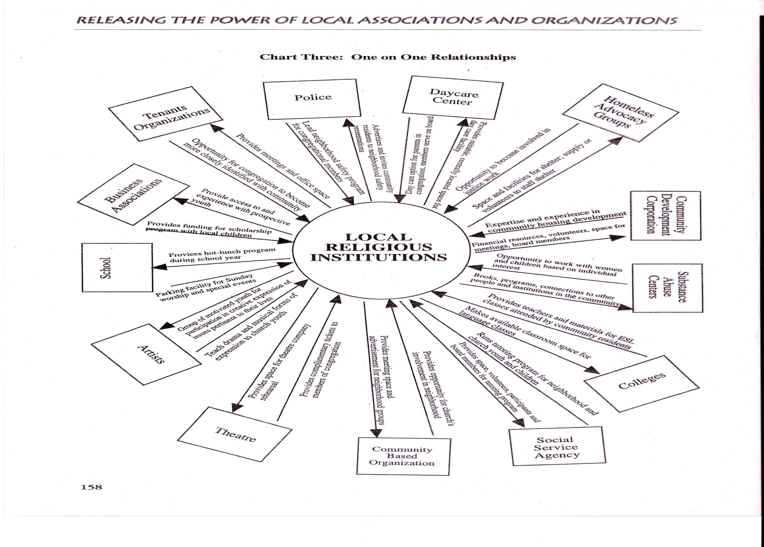
Social capital - the connections among individuals, social networks-with reciprocity; the more relationships someone (or some institution) has in their community, the more likely to be effective, employed, engaged, volunteer

Slide 42
INVITATION
God is inviting all children of God to get OUT of their comfort zones to see God at work in the world.
Building relationships and partnerships we will find many who are doing God’s work without knowing it.
We might be able to connect and learn together how God’s dream is becoming a reality there. By God’s grace, churches will be renewed and new ministries will be called into existence.

Slide 43
ELCA: A Community in Mission
Building relationships in the public arena
Restoring community
At home in church and world
Listening, learning, serving, witnessing, being blessed in our neighbors.
Jeremiah 29:7 Seek the welfare of the community where I have sent you, and pray on its behalf, for in its welfare you will also find your welfare.

Slide 44
Learnings from Leaders

Slide 45
Learning#1: Neighbors, from objects to subjects.
We are sent to listen, learn, serve, walk alongside, witness and experience God’s hospitality in and through the neighbor
Neighbors share clues to design ministry that is contextual and community owned.
People support what they create.

Slide 46

The Leaven Project, Portland, OR
“Leaven Project, an ELCA new start, is an open and growing community. We aim to be in intentional relationship with one another, listen to others and share our own stories, and build capacity/power among in order to organize for justice and the common good. This is our definition of beloved community. People found God in each other and in the neighborhood”.
The host church, Redeemer Lutheran closed its ministry and resourced this new ministry now called Salt and Light Lutheran Church, Pastor Melissa Reed.

Slide 47
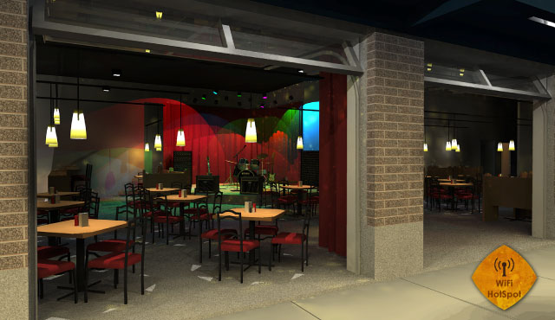
Luther’s Table, Renton, WA
Café? Church? Bar? YES!

Slide 48
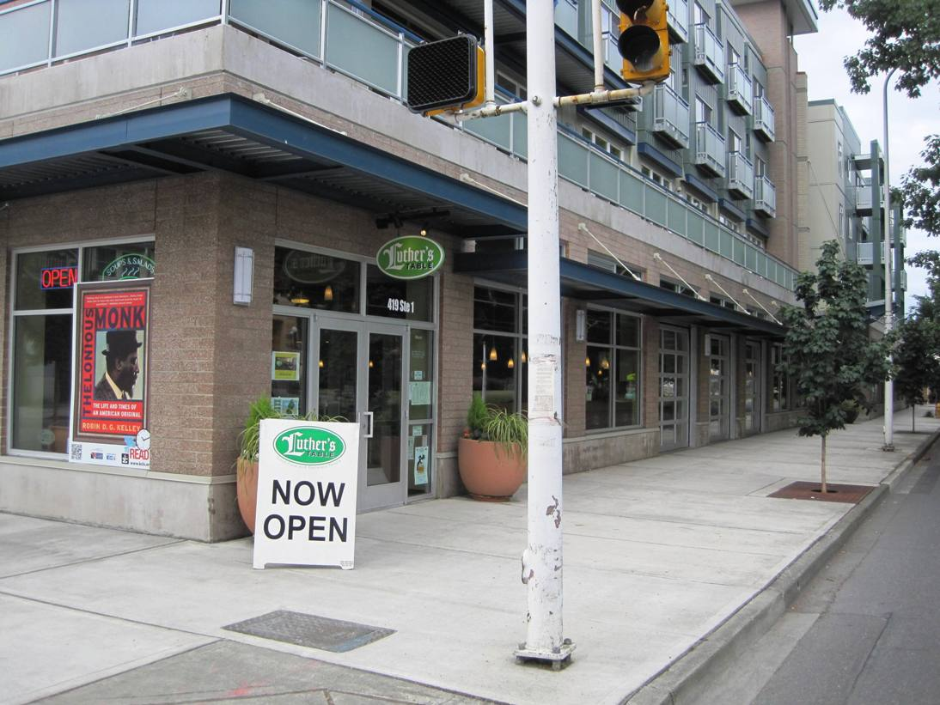
Seattle: Luther’s Table ELCA

Slide 49
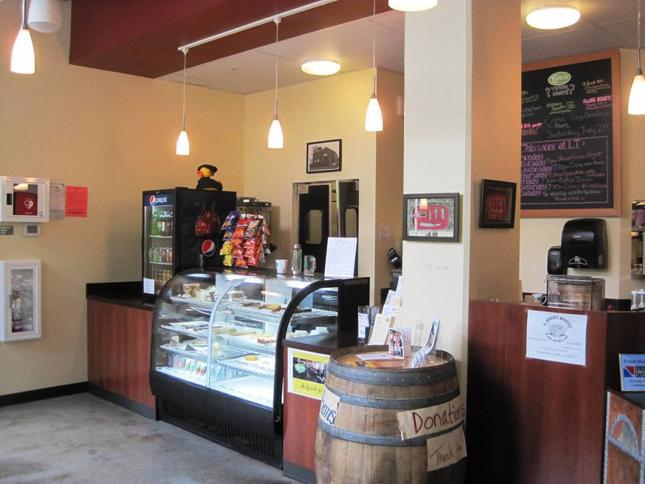
Seattle: Luther’s Table ELCA

Slide 50
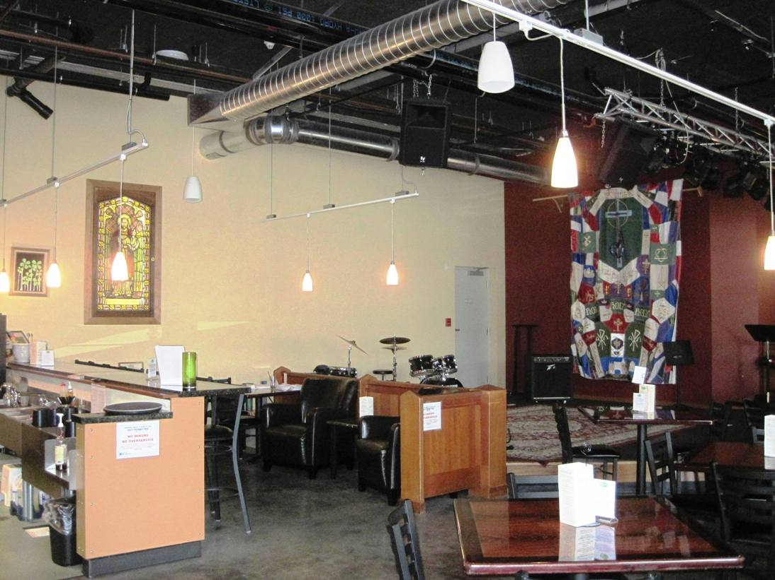
Seattle: Luther’s Table ELCA

Slide 51
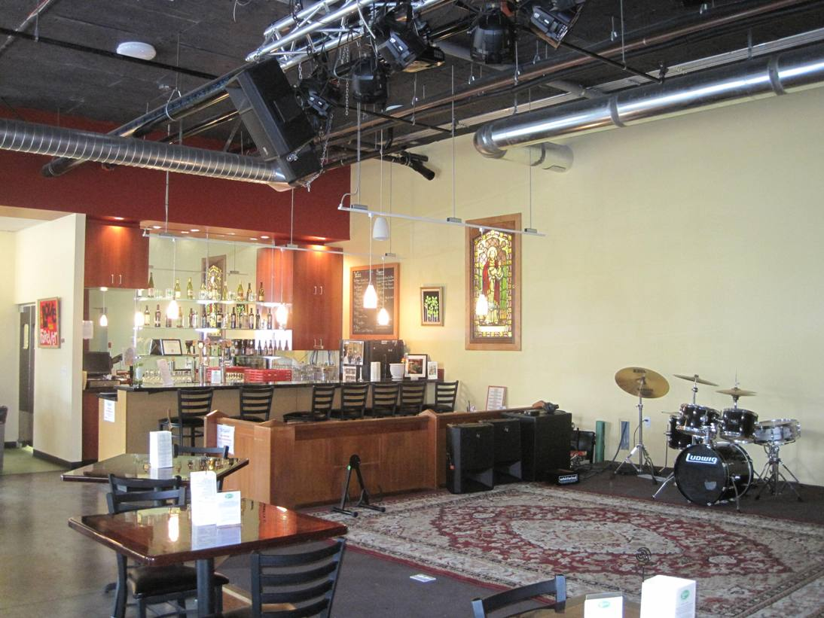
Bar is tended by the 5 area ELCA pastors…
Seattle: Luther’s Table ELCA

Slide 52
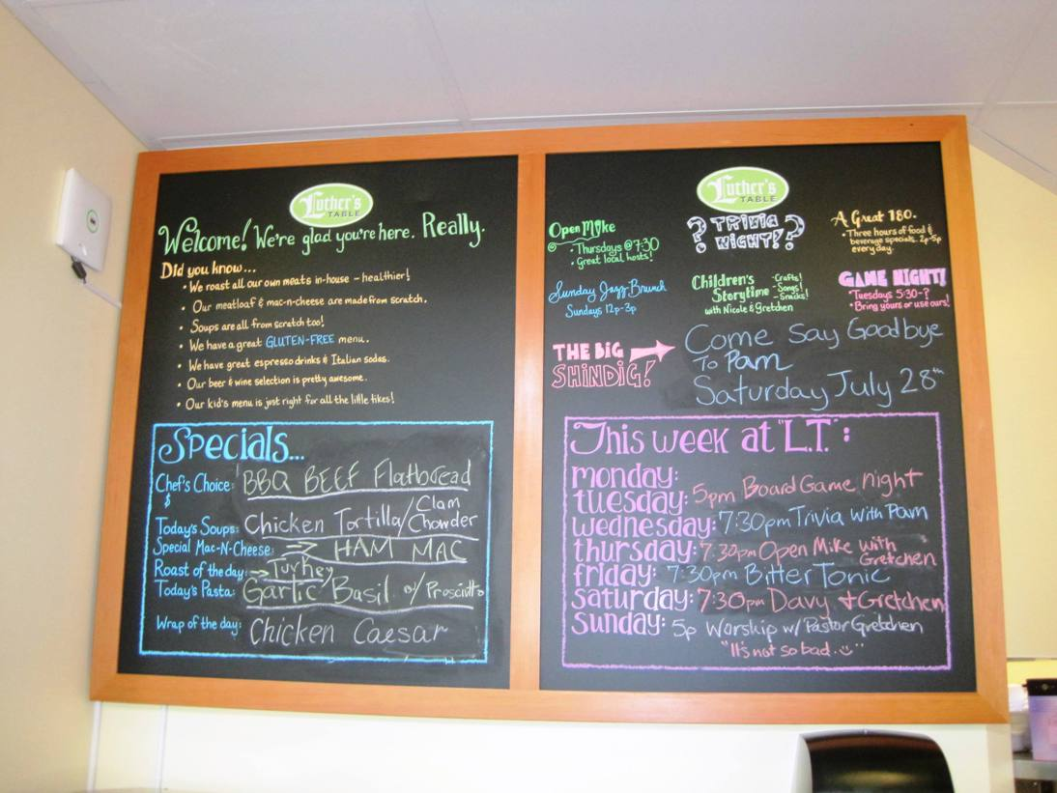
Seattle: Luther’s Table ELCA

Slide 53
#2: Mission calls us beyond cultural boundaries
Jesus in Samaria
Across ethnic barriers
Across socio-economic boundaries
Bridging generational and sexual orientation gaps of understanding in church and society
Among people in the margins
Among peoples without a faith community
Turning vertical walls into horizontal tables for communal understanding and planning.

Slide 54
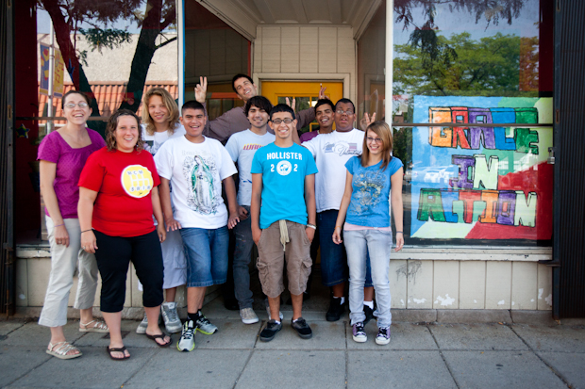
Grace in Action, Detroit, MI
An emergent 2nd generation Latino youth church.
Jam sessions at Café con Leche restaurant.
Youth becoming entrepeneurs, able to help family and church
Faith is the glue, using community organizing principles and tools
Donated building renovated to multiply ministry

Slide 55
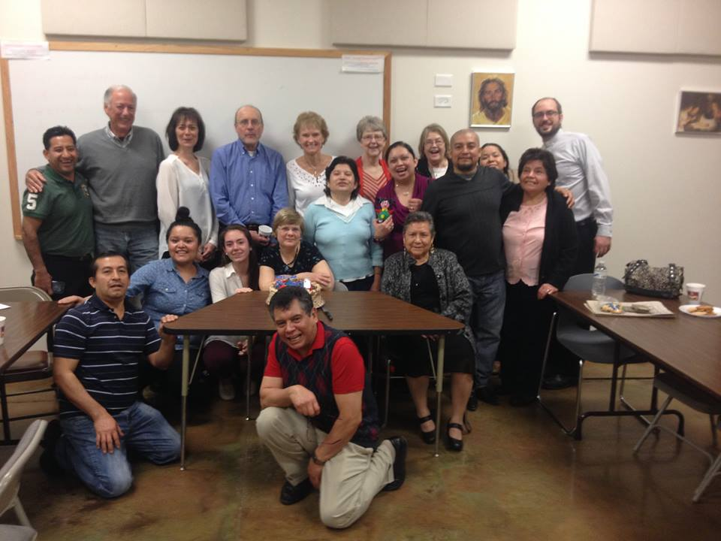
CROSS CULTURAL CAFE

Slide 56
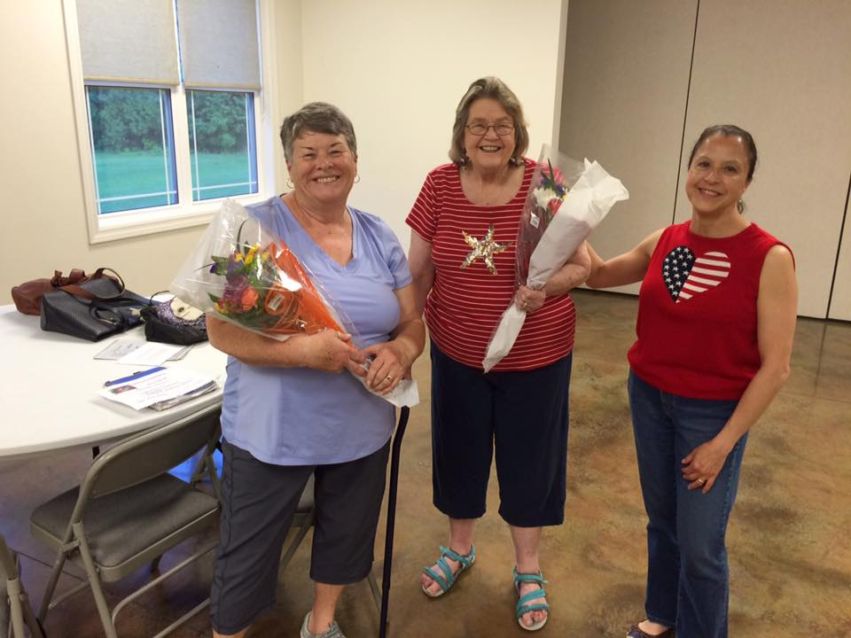
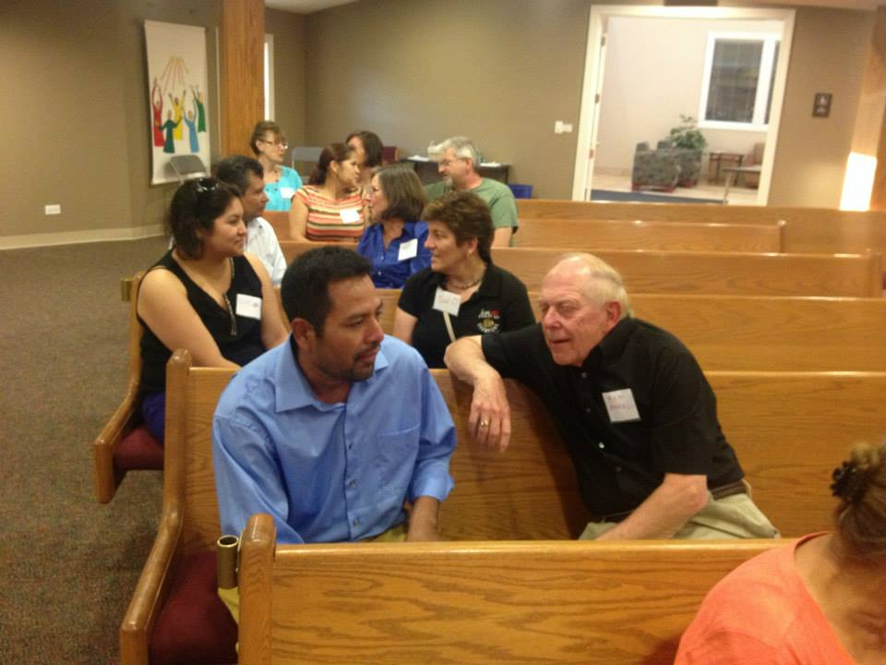
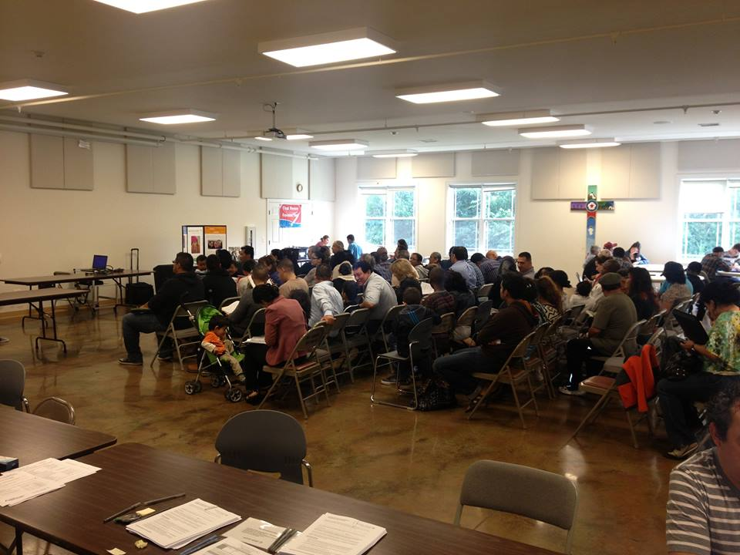
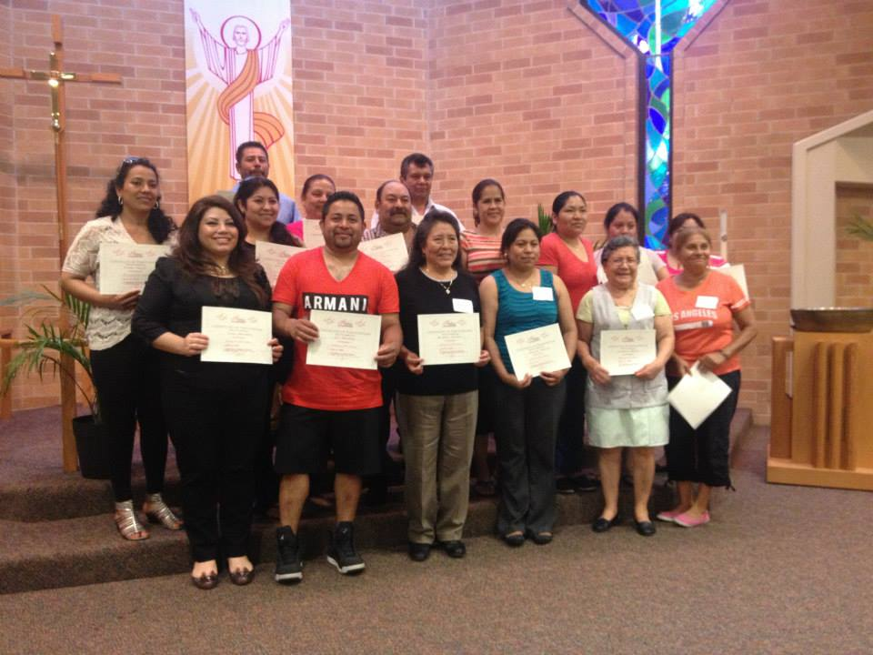
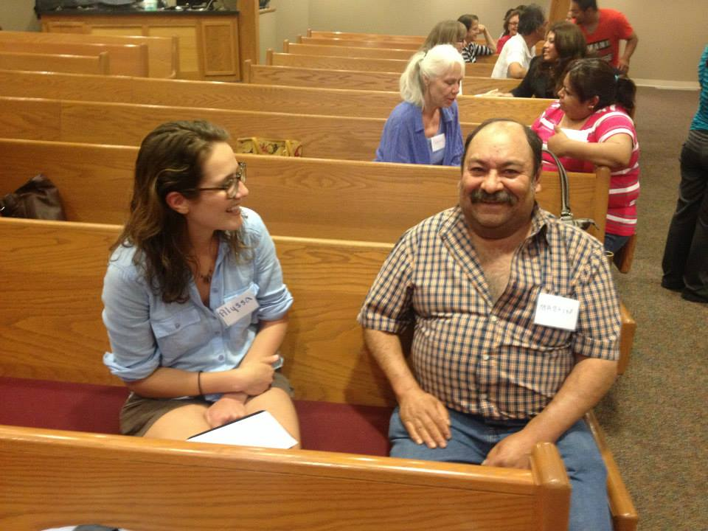
ESL

Slide 57
Learning #3: Leadership is not singular but plural
Like the Sending of the 70, by Jesus
Releasing all of God’s people as missionaries of grace, receiving God’s hospitality in the public arena
Accompanying civil society
Called, gathered and scattered people of God.

Slide 58
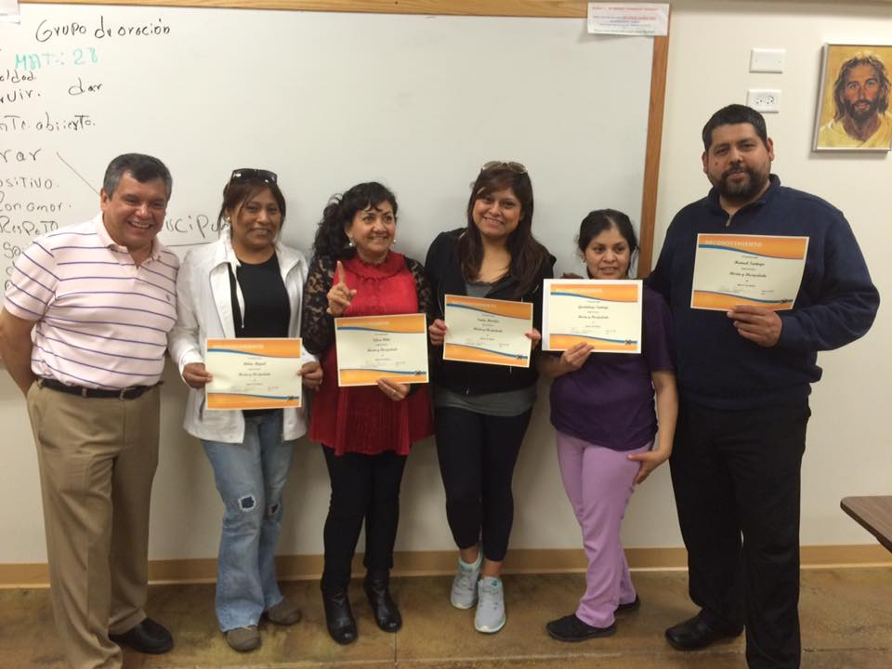
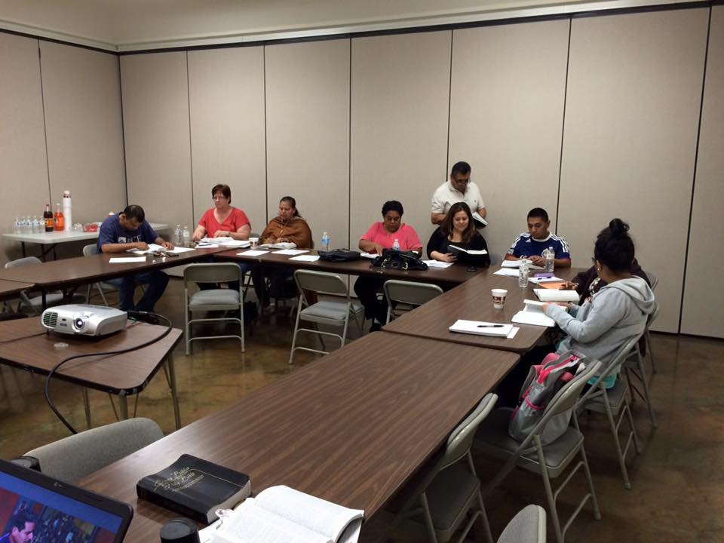
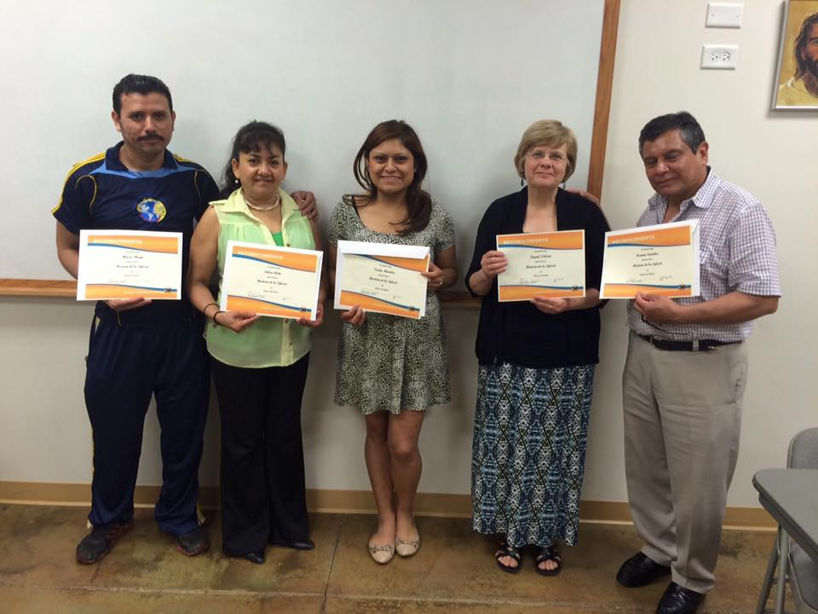
ACADEMIA DE LIDERAZGO

Slide 59
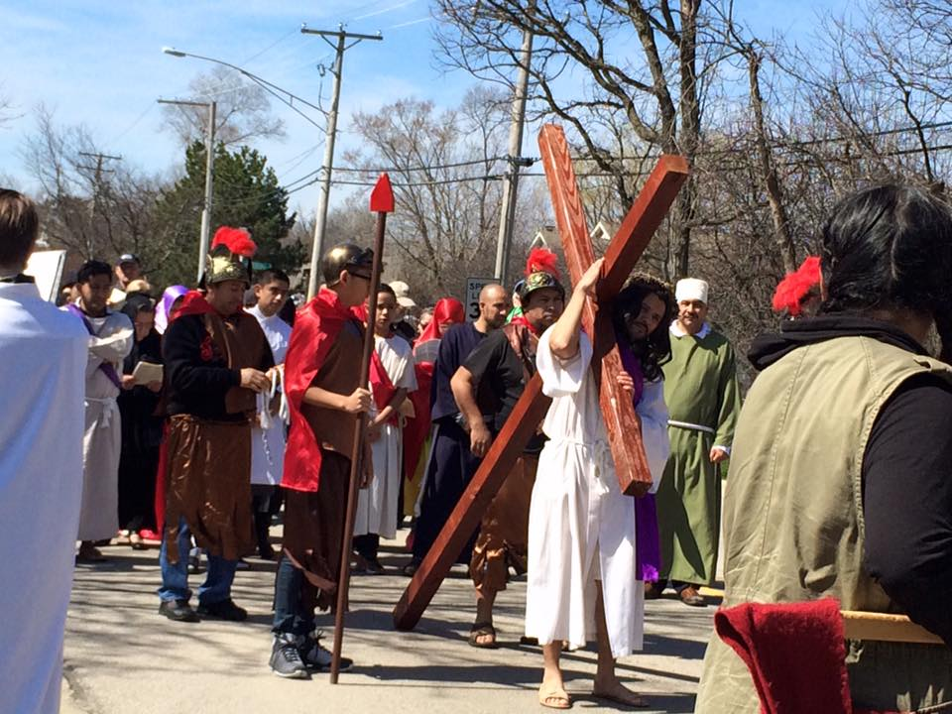
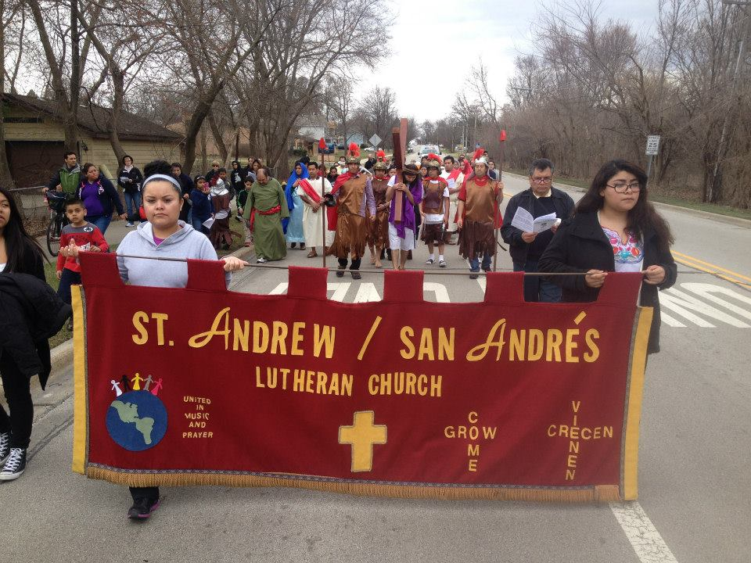
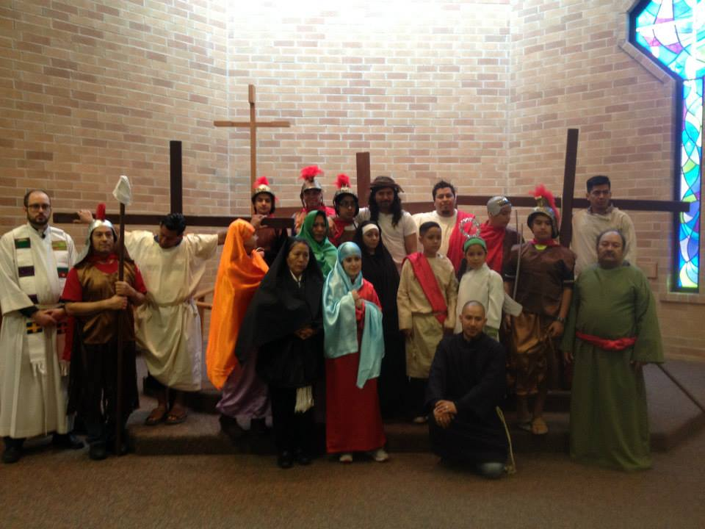
VIA CRUCIS

Slide 60
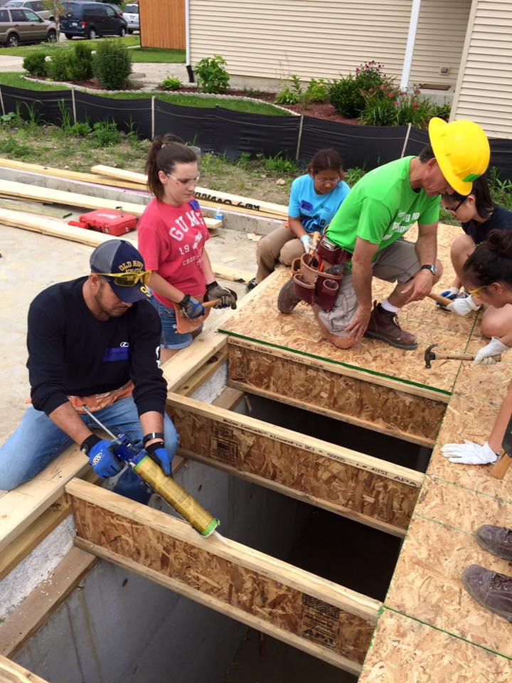
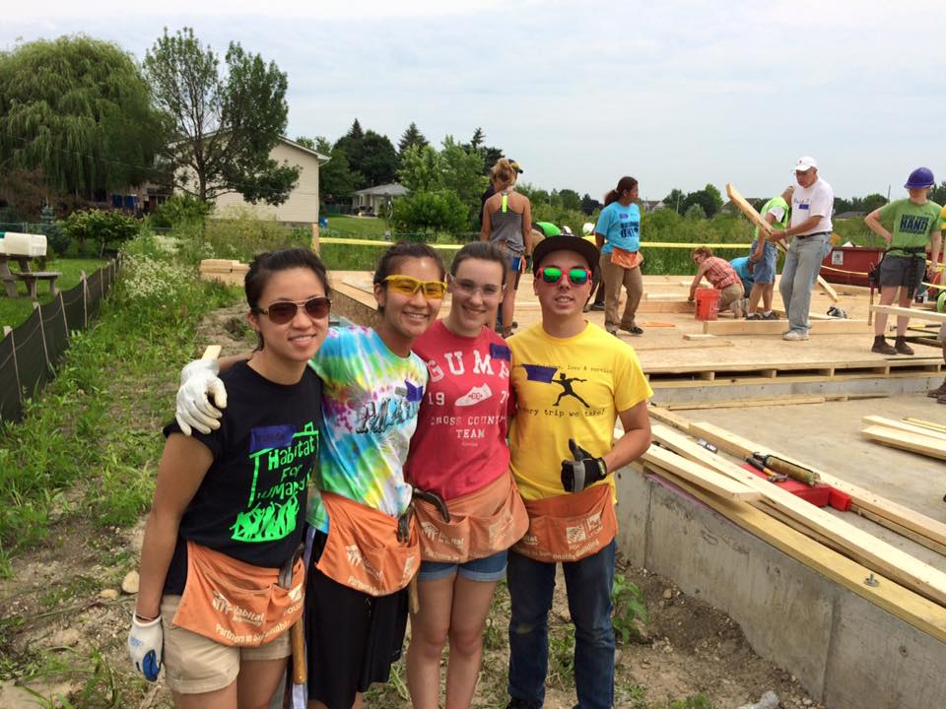
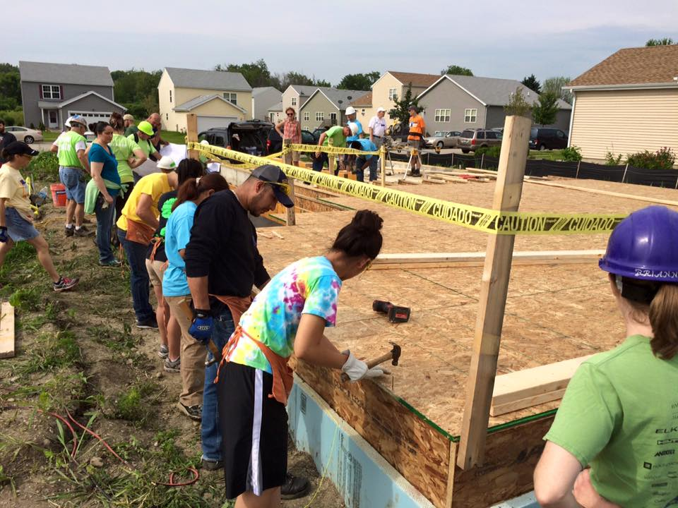
HABITAT FOR HUMANITY

Slide 61
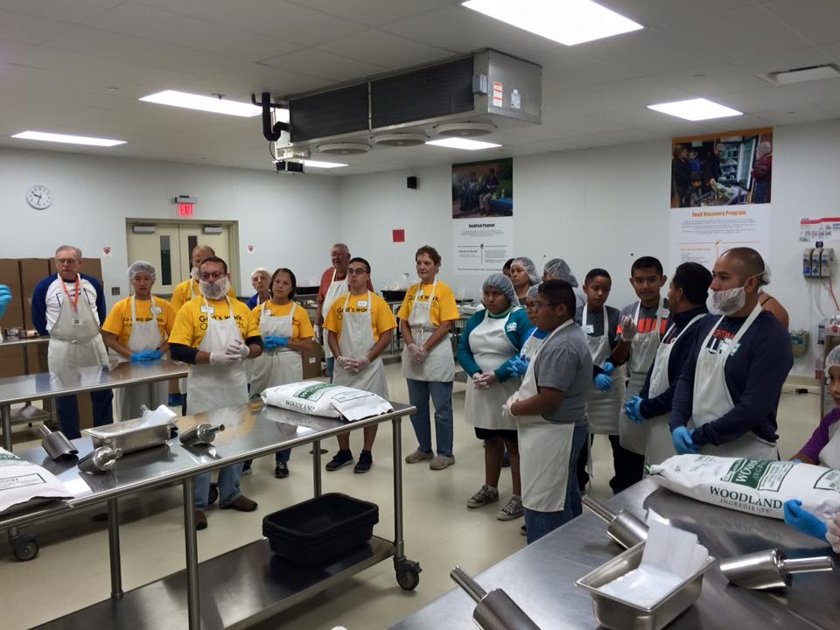
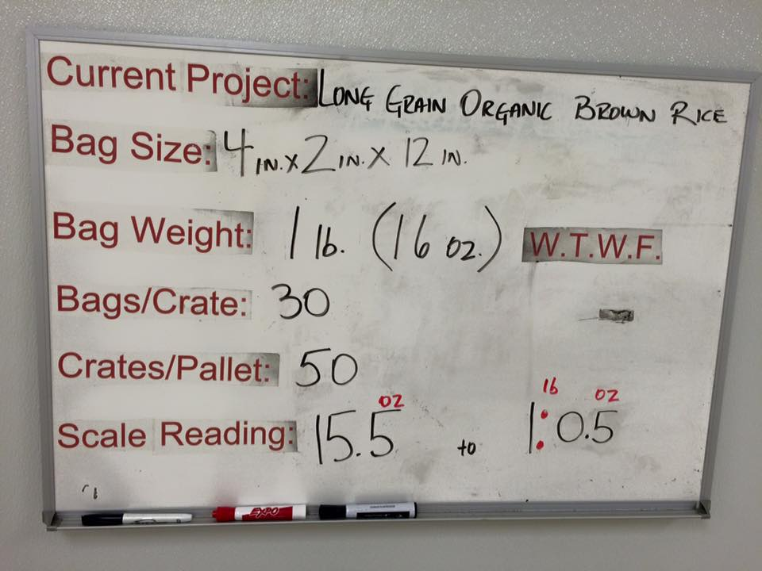
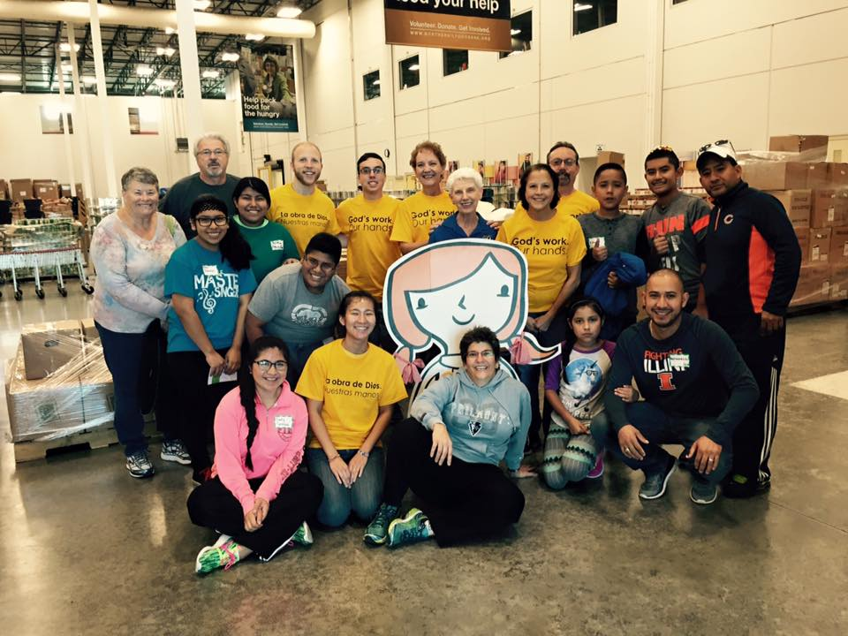
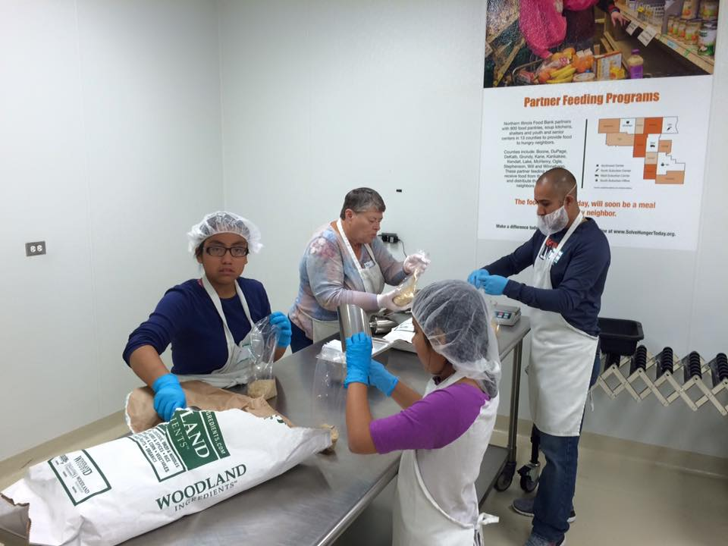
GOD’S WORK, OUR HANDS

Slide 62
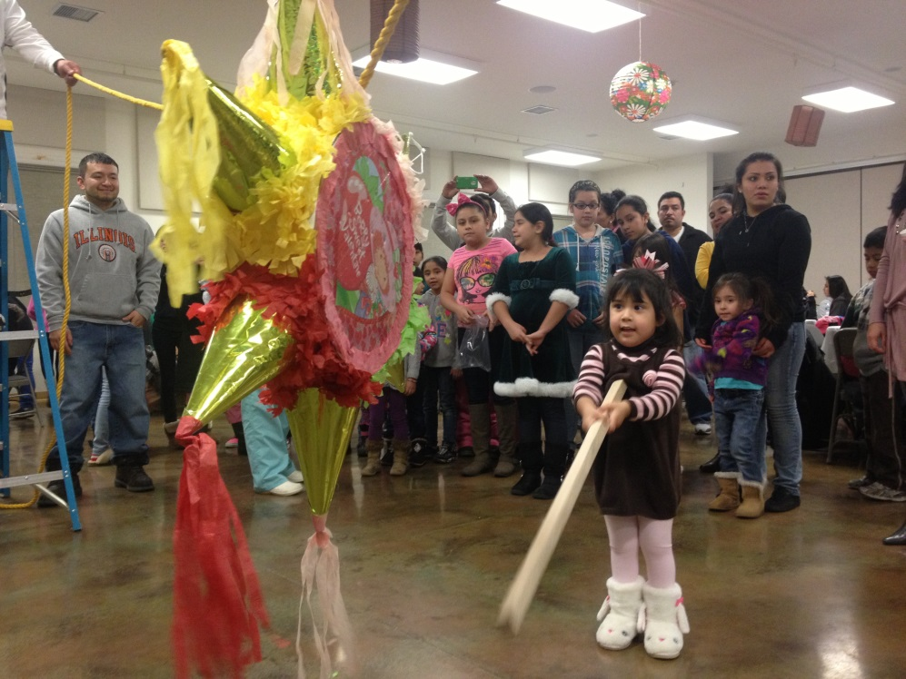
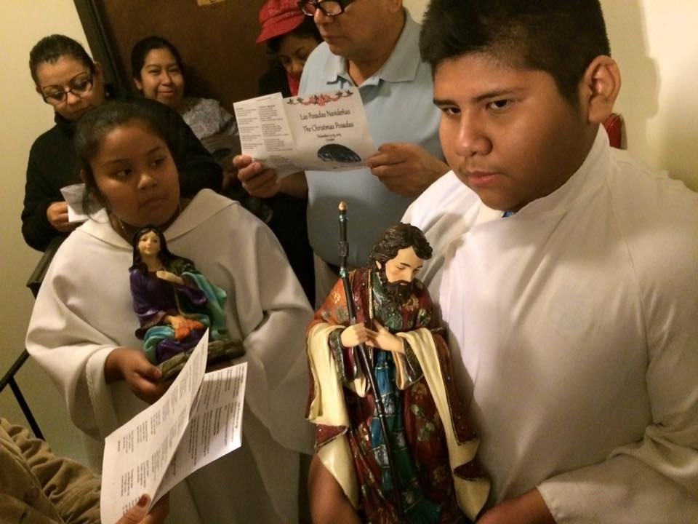
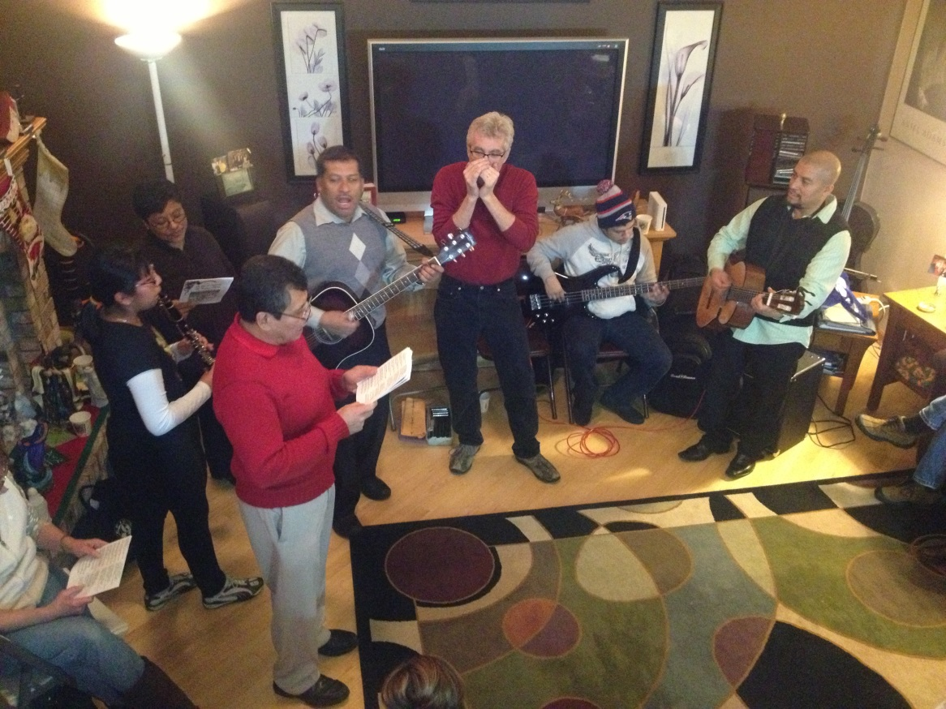

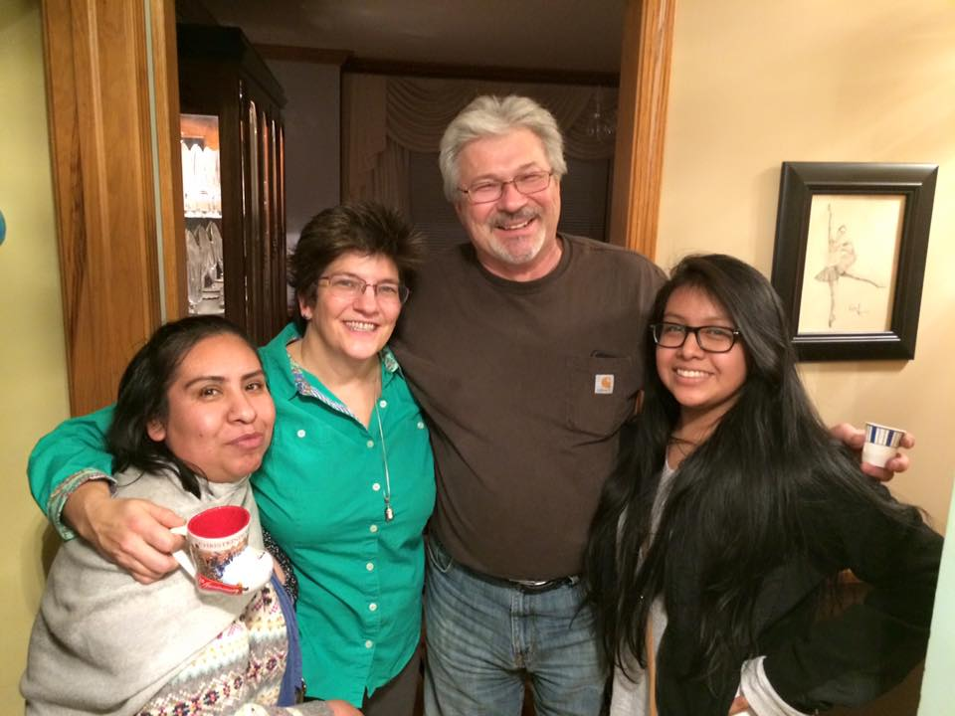
LAS POSADAS

Slide 63
Learning #4
We are being invited to become
DETECTIVES OF DIVINITY
IN EVERYDAY LIFE
What is God up to today?

Slide 64
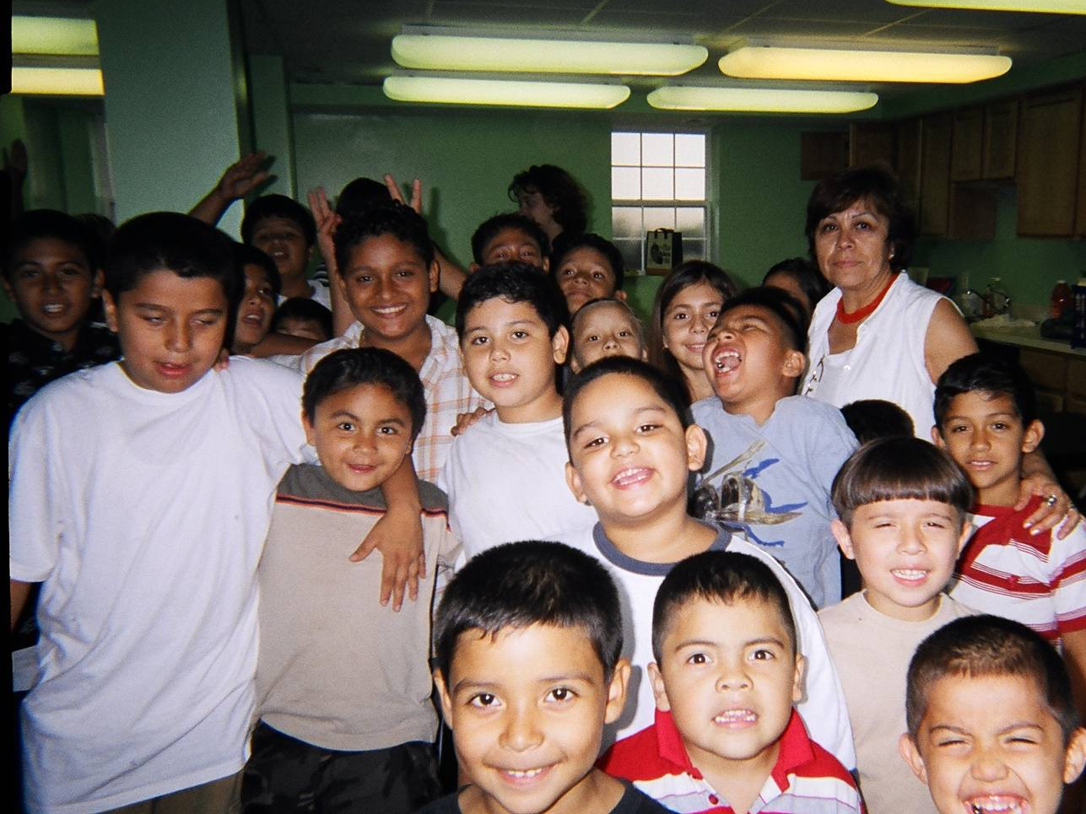

Slide 65
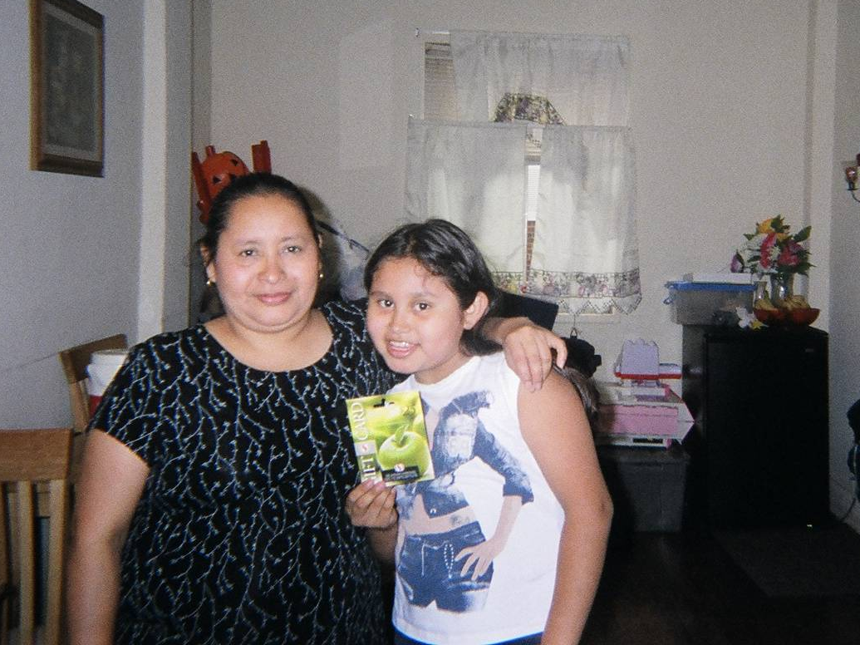

Slide 66
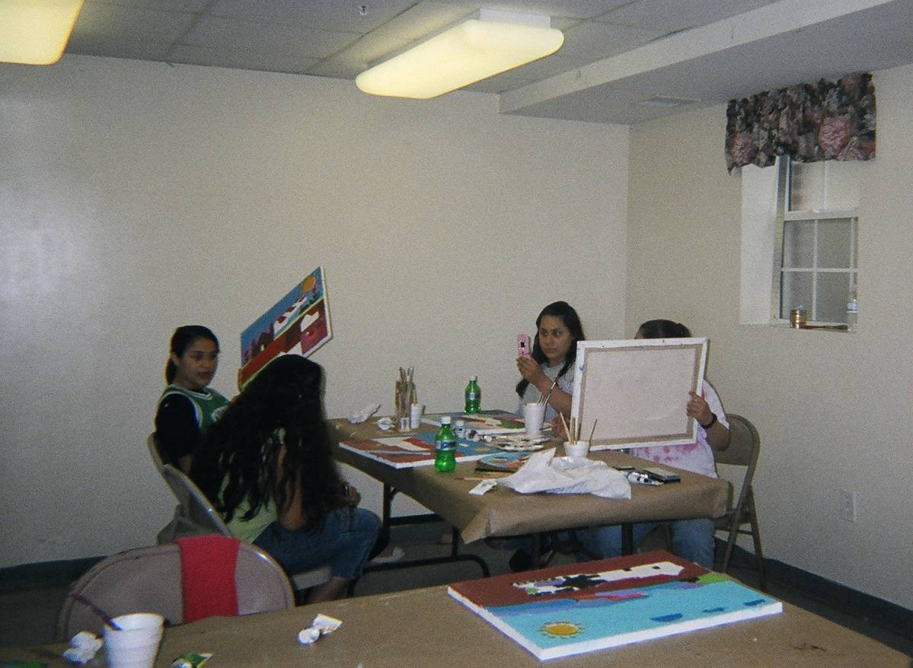

Slide 67
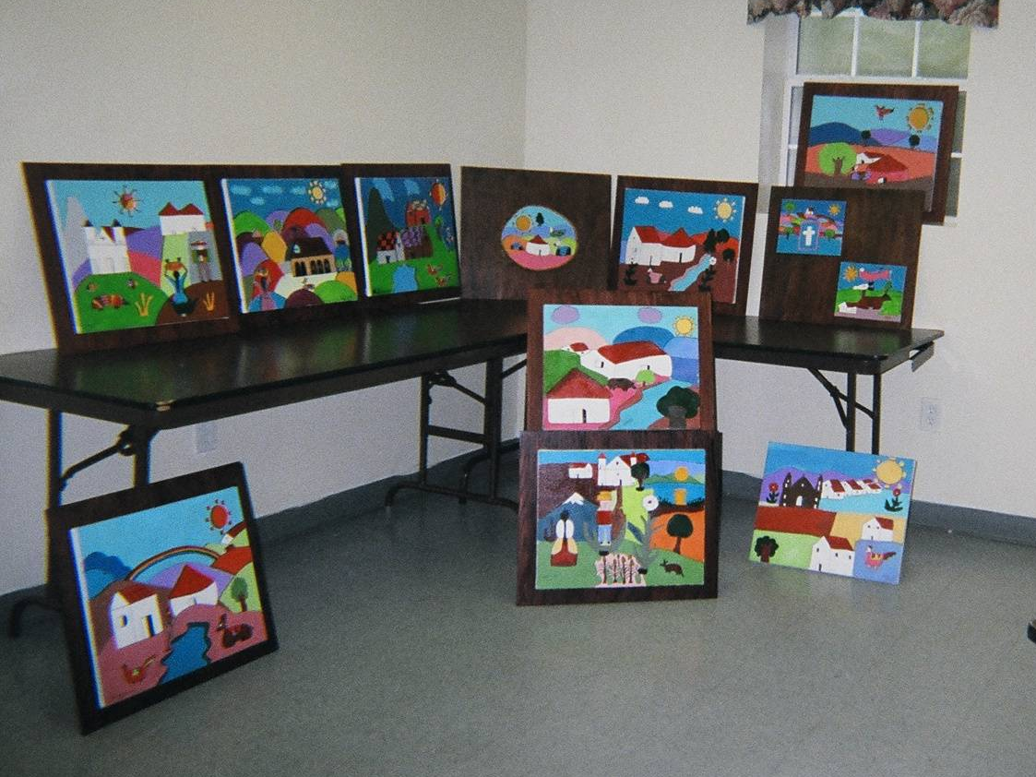

Slide 68
Think and Share
As a “detective of divinity”, where have you seen God at work lately?
In your life
In your church
In your community
Any ideas how you can participate in it?

Slide 69
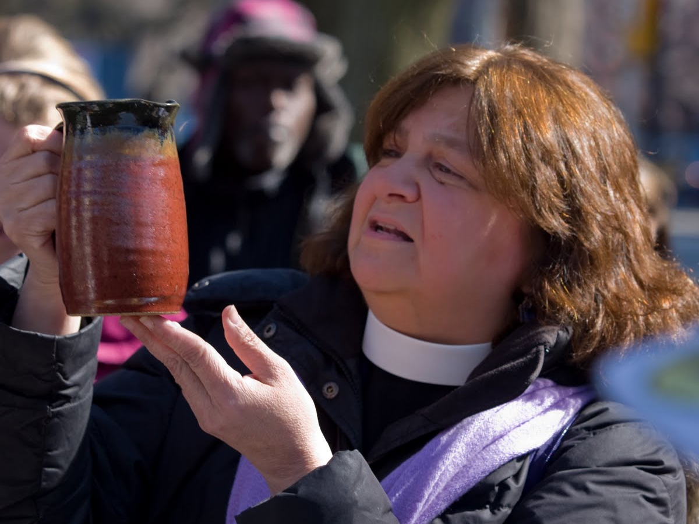
Pastor Developer Violet Little
The Welcome Church, ELCA,
Philadelphia

Slide 70
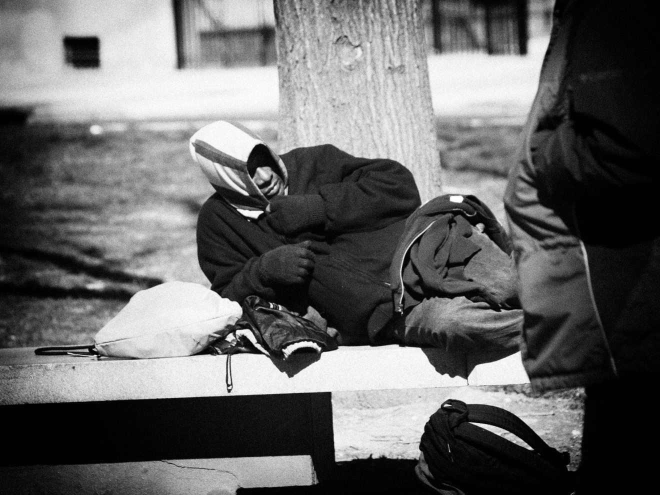
The Welcome Church, ELCA
Philadelphia

Slide 71
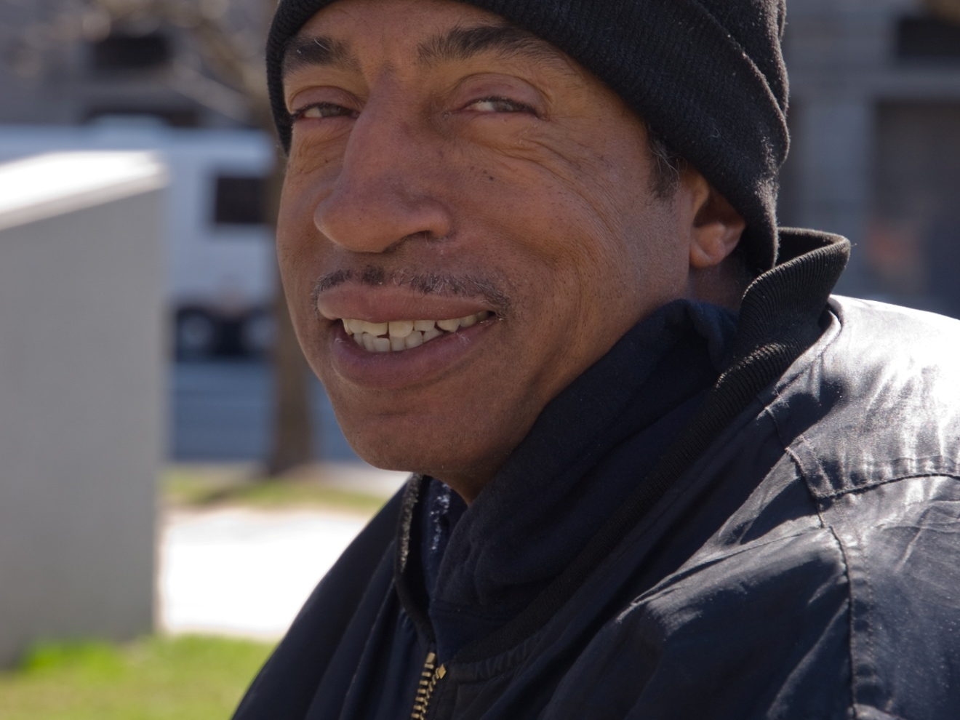
Carl
The Welcome Church, ELCA
Philadelphia

Slide 72
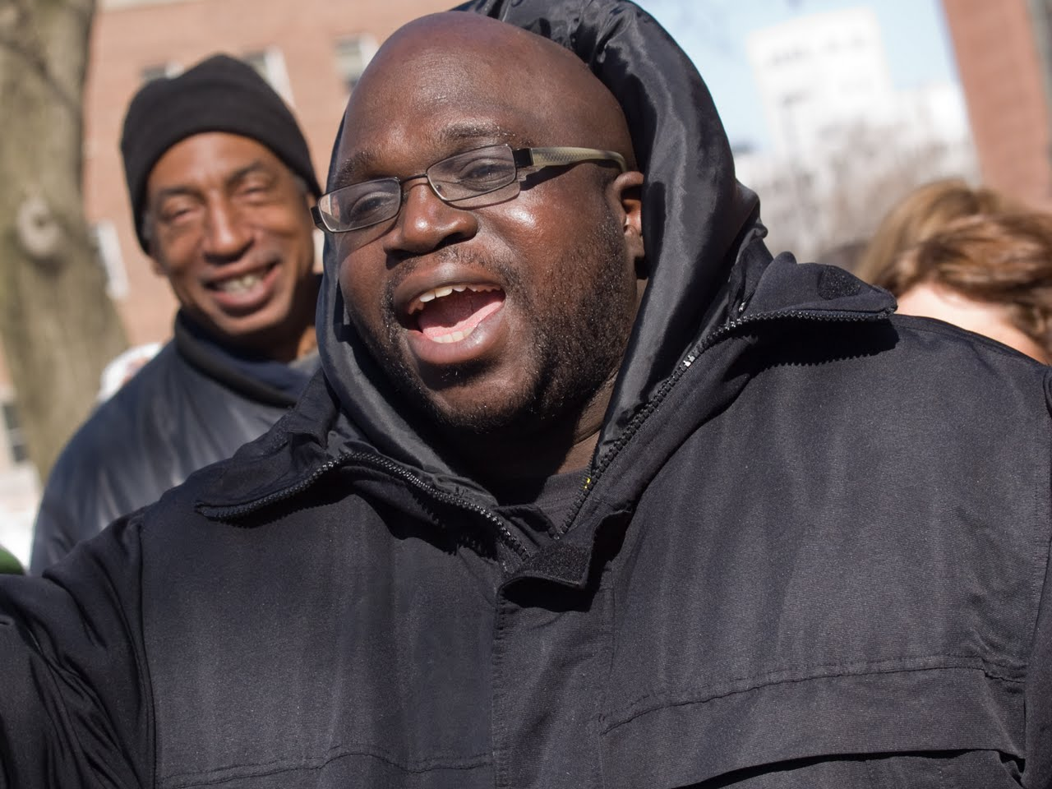
Choir Director
The Welcome Church, ELCA
Philadelphia

Slide 73
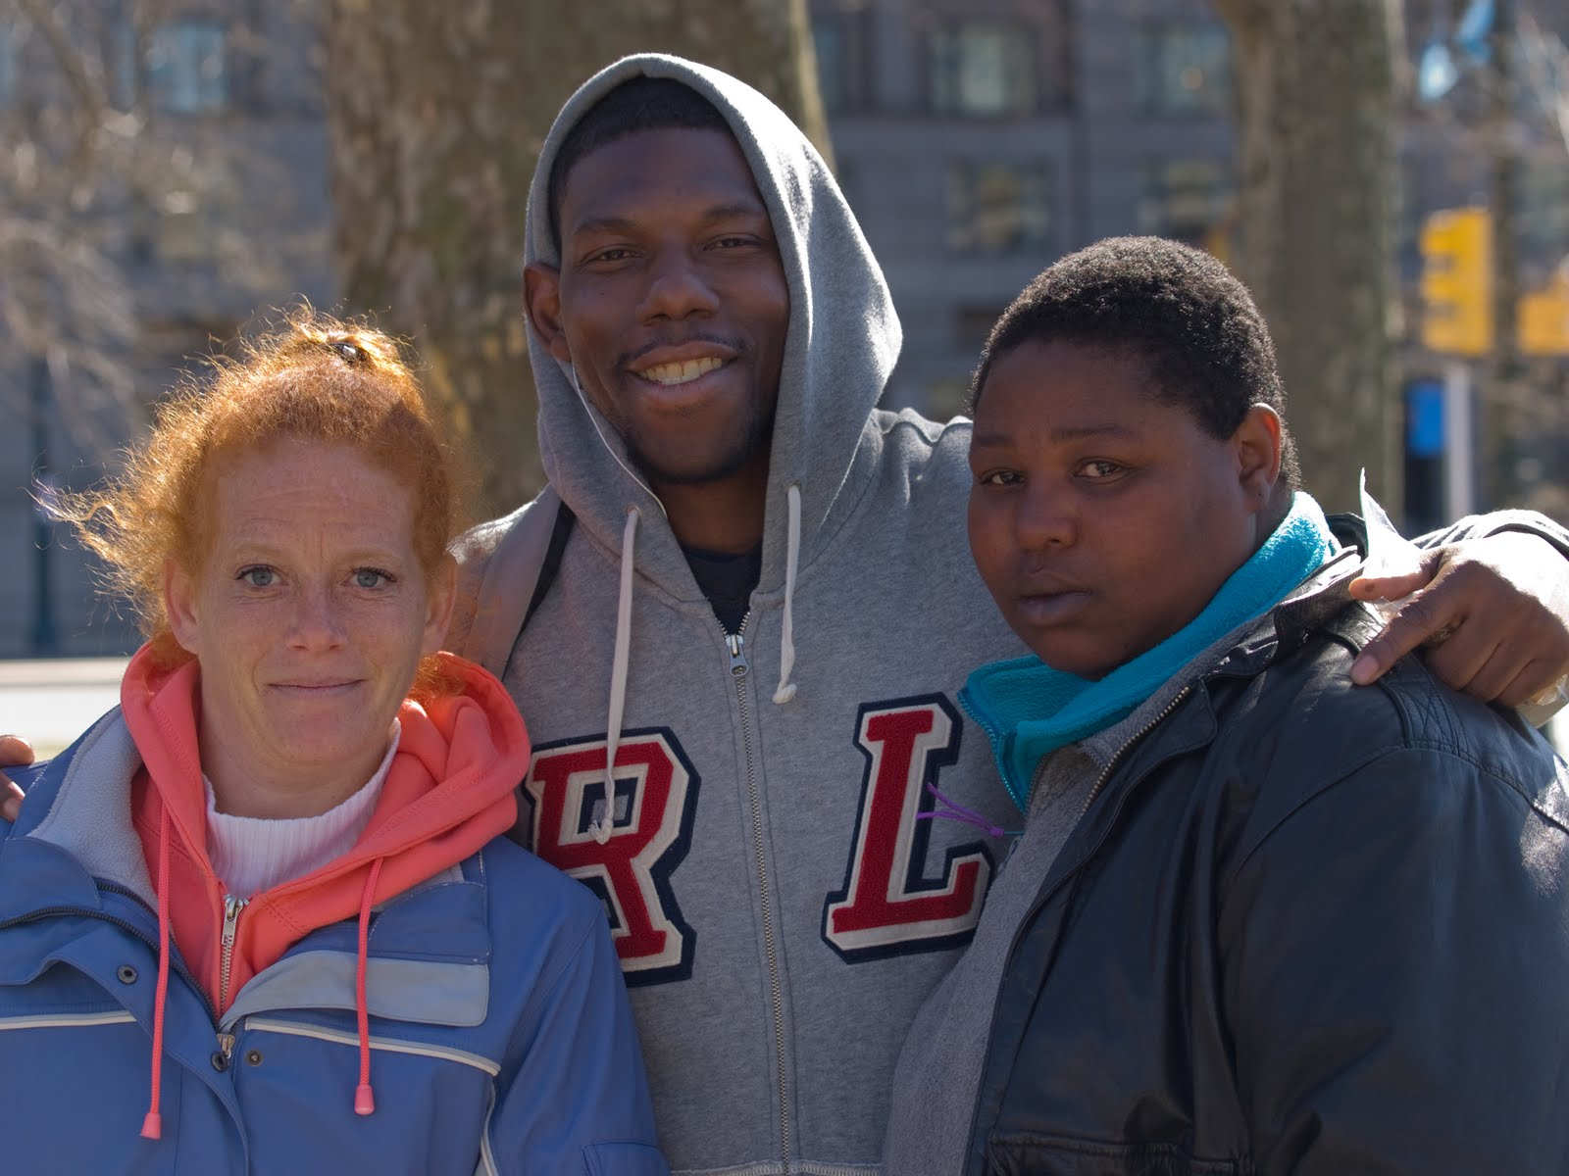
Friends at the Welcome Church

Slide 74
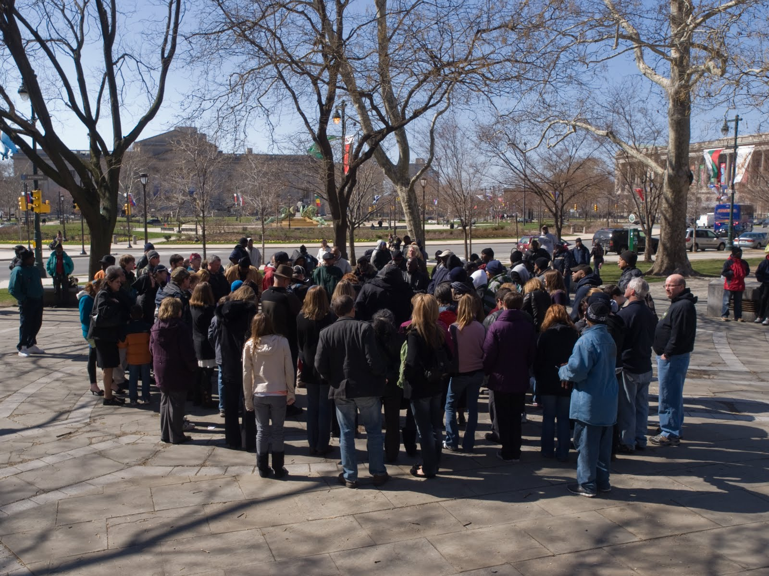
The Welcome Church, Logan Site
Philadelphia

Slide 75
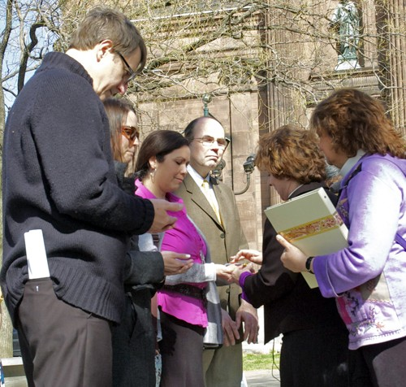

Slide 76
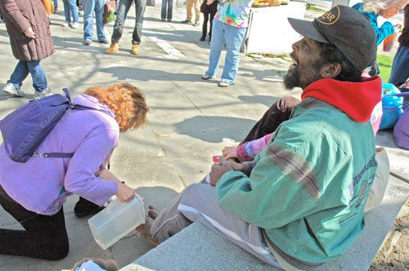

Slide 77


Slide 78


Slide 79


Slide 80


Slide 81


Slide 82

Coffee hour after worship

Slide 83
What’s next?
A coalition of community leaders are coming together to plan for addressing the roots of homelessness in Philadelphia.
Medical doctors and other professionals are meeting with Bishop Claire Burkat to intensify their service.
Pr. Little and others begun an ELCA/Ecumenical network of ministries among the homeless to resource communities, support each other and pray for uprooting homelessness everywhere.

Slide 84
LEADERSHIP FLOW
Violet found Linda……new Pastor
Linda found Shaunel, Presbyterian partner
Violet and Linda found David, Episcopal; opened Welcome Church in El Cajon, CA
Linda and Violet found Waverly, called to ministry, ELCA
The community also raised, nurtured and sent Rob to Paris, starting street ministry.

Slide 85
Observation
Church is not dying, it is changing
We are invited to step out into the arena of God’s mission in public squares, as “detectives of divinity”.
The mission of God will define the church we are becoming. God has done it before!!

Slide 86
Detectives: TRUST THE PROMISES
Jesus: …”I will build my Church…”
Jesus: …”I will be with you always…”
Jesus:…..”I am making all things new”
God, through Isaiah: …”My word will never come back empty, but will always accomplish the purpose for which it is sent”.

