Slide 1
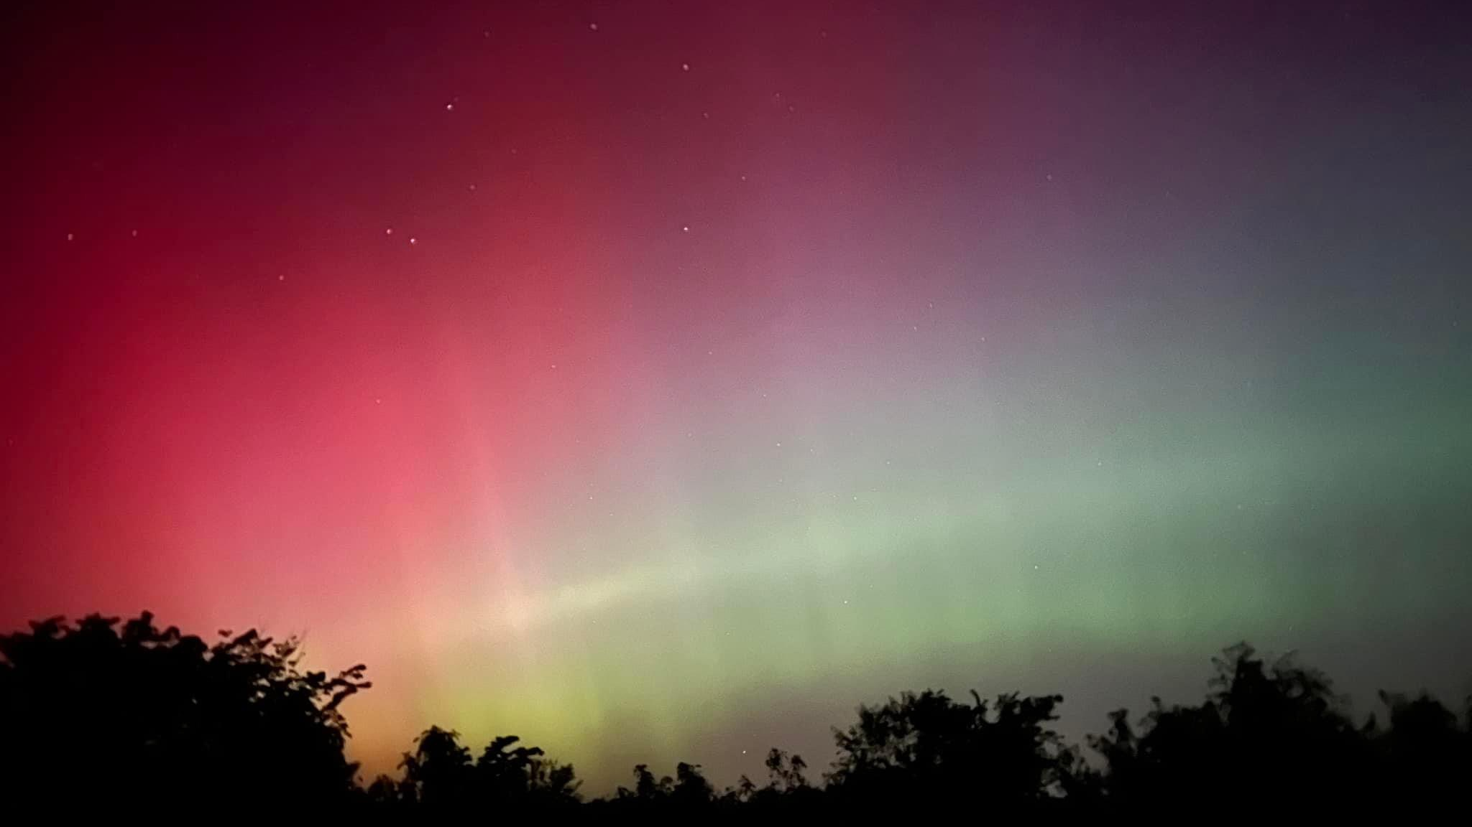

Slide 2
Land Acknowledgement
We are here today,
and we remember that we are not the first.
2000 years ago, those known today as
the Hopewell civilization
were here long before us.
We give thanks for the Hopewell
and their care of the land.

Slide 3
Land Acknowledgement
We are here today,
and 1300 years ago,
those known today as the Mississippians
were here long before us.
We give thanks for the Mississippians
and their care of the land.

Slide 4
Land Acknowledgement
We are here today,
and we remember
the Osage and the Kaw
were here long before us.
We give thanks for Osage and the Kaw, and their care of the land.

Slide 5
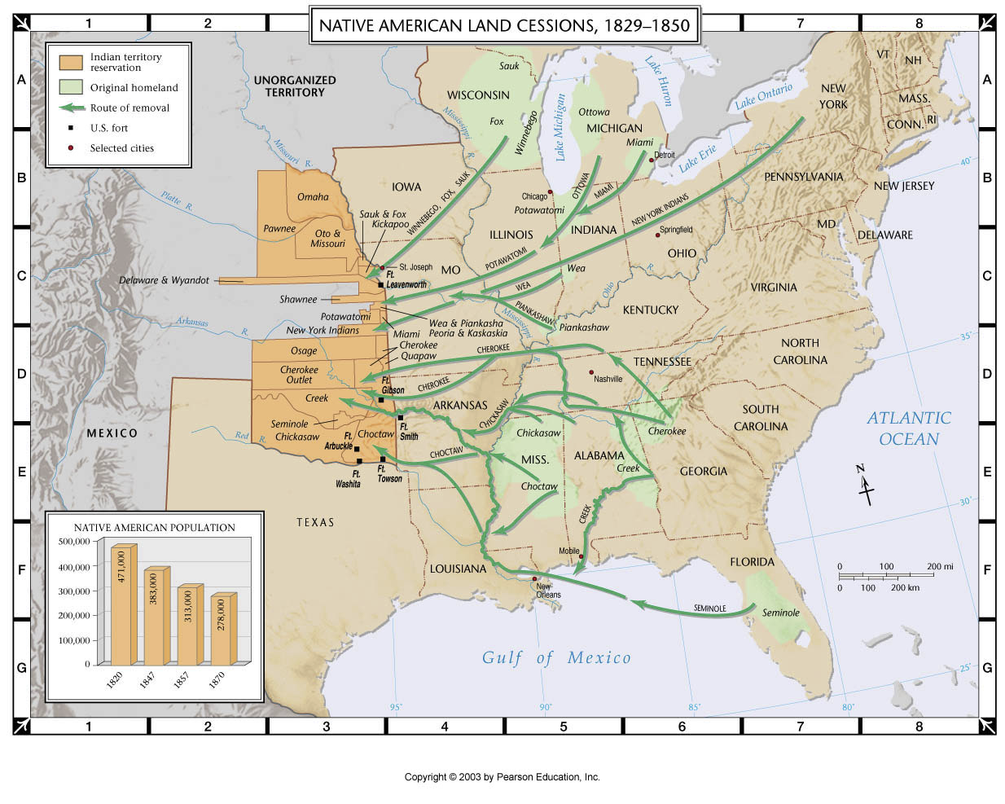
Land Acknowledgement
We are here today,
we remember,
and we grieve
over the Native people who were driven here by exploitation and force
two centuries ago . . .

Slide 6
Land Acknowledgement
We remember
the Shawnee, the Wyandotte, and the Kickapoo, forced here from their lands
in Ohio, Indiana, and Kentucky.
We remember, we grieve,
and we give thanks for their care of the land.

Slide 7
Land Acknowledgement
We remember
the Munsee and the Delaware,
forced here from their lands
in Delaware, New Jersey, New York,
and Pennsylvania.
We remember, we grieve,
and we give thanks for their care of the land.

Slide 8
Land Acknowledgement
We remember
the Potawatomi,
forced here from their lands
around Lake Michigan
in Michigan and Indiana.
We remember, we grieve,
and we give thanks for their care of the land.

Slide 9
Land Acknowledgement
We remember
the Sac and the Fox,
forced here from their lands
in Illinois and Wisconsin.
We remember, we grieve,
and we give thanks for their care of the land.

Slide 10
Land Acknowledgement
We are here today, and we acknowledge
that we are not the first.
For all the Native people who came before us,
we remember;
for their suffering at the hands of colonizers,
we grieve;
for their centuries of care for this land,
we give thanks.

Slide 11
Land Acknowledgement
We are here today, and we give thanks
for our Native neighbors.
For all the Native people who are around us,
we give thanks.
For all the Native people who are among us,
we give thanks.
For all the Native people who shape our lives,
we give thanks. Amen.

